Slide 1


Potential of wearables to improve health and fitness
Habify+ (Fitness and wellbeing app)
Created by InsightMasters
Junction 2023

Slide 2






Our Team - InsightMasters
Varun S
Nithin VS
Sudharsun L
Kamal T

Slide 3

Challenge
Create innovative and captivating features for mobile and wearable devices that resonate with the youth, encouraging them to reduce sedentary behaviors and embrace more a physically active lifestyle.
A lifestyle that is predominantly sedentary among children poses significant risks such as obesity, cardiovascular ailments, and mental health issues, thereby hindering their physical and cognitive development. Regular physical activity is crucial in reducing these health risks and promoting overall well-being.

Slide 4
Target group
On average, children who participated in after-school care or other programs spent 41% and 51% of the session engaged in sedentary activities. Similarly, adolescents spent 57% of their after-school time in sedentary pursuits.
57%
Parents who work full-time often struggle to dedicate ample time towards their children's mental and physical health.

Slide 5

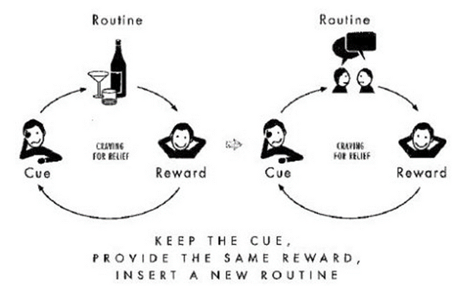
Proposed Solution
Introducing Habify+, an innovative solution designed to empower children towards healthier lifestyles. Our approach involves personalizing activities and incorporating a reward system utilizing advanced wearables and machine learning. By integrating families, we cultivate a supportive and health-conscious social environment, promoting a holistic approach to an active lifestyle.

Slide 6

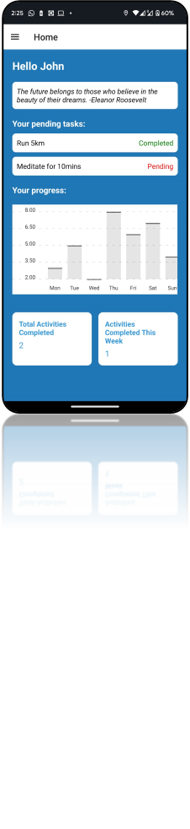
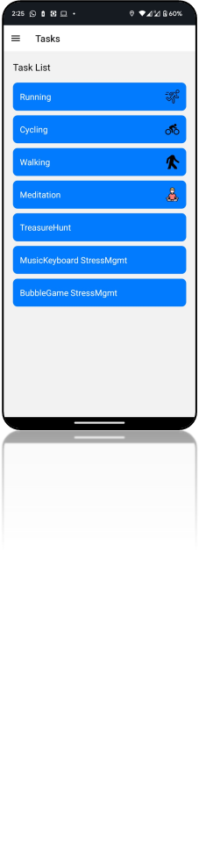
Habify+
Key Features:
Interactive, gamified - streaks and points
Parental dashboard - guidance
Edge computing - faster analytics
Age and BMI specific tasks and activities - for Kids
Stress Management - For mental wellbeing
Diverse physical challenges - tresure hunt

Slide 7

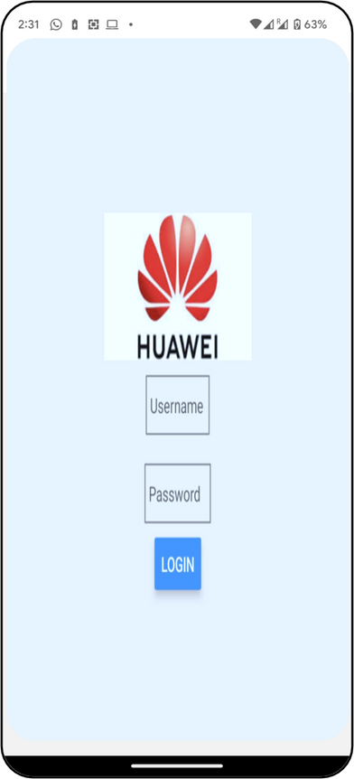
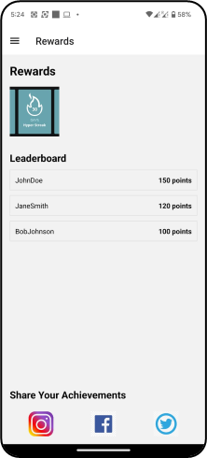
Business Model
As a revenue generating business model, we are proposing the multiple platforms to be included with the application, making sure that platform economy exists among the users, third party players.
The app can collaborate with health professionals for expert advice, offer specialized programs and consultations for a fee, and partner with schools for a subscription model.
Additional revenue can be generated through sponsorships and brand collaborations with branded challenges, themes, and events within the app.

Slide 8

Demo
Demo App link: exp://192.168.0.125:19000 (App platform is Expo Go, which needs to be installed )
Github link: https://github.com/VARUN7111/Habify_Plus

Slide 9
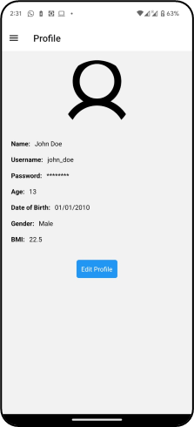
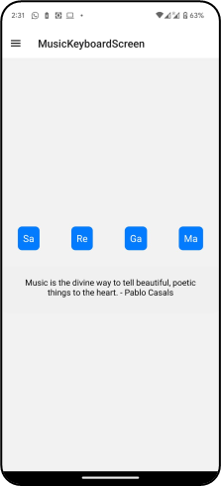
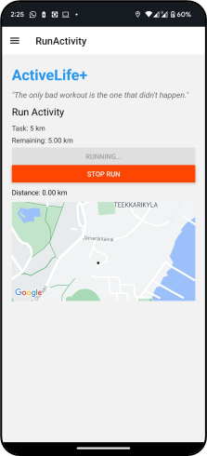
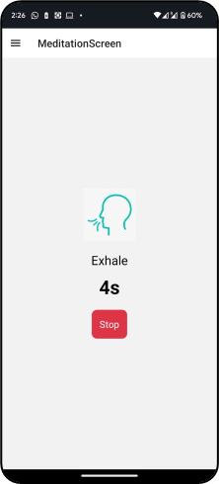
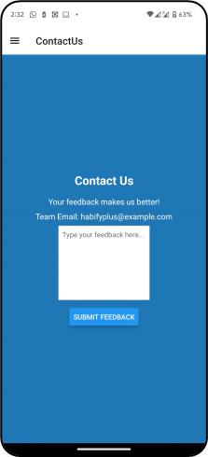

Demo Snaps

Slide 10
Thank You
Business Strategy Team

Slide 11
Contact Us
Team InsightMasters
Mail: varunshan2001@gmail.com
Phone No: +358 415767254

